Slide 1
RADHAKRISHNaFINANCE GROUP

Slide 2
Synopsis
“RADHAKRISHN FINANCE GROUP"
Bachelor of Computer Applications
Submitted By:
Kishor Kawale
Raheen Aga
Akshata Desai

Slide 3
ABSTRACT
Society is one of the most important financial activities. There are various activities. Once a user or admin login into account he or she can check the all transaction details. Security related to transactions and account login activity.

Slide 4
INTRODUCTION
Radhakrishn finance group is developed to manage the financial activity.
The website is defined to accept and safeguard money owned by individual and they lend out the money in order to conduct economic activities
The website will have all the transaction details like debit , credit, loan details, customer details with privacy and security.

Slide 5
EXISTING SYSTEM
Extra paper work
Difficulty in maintaining records.
No online transaction facility
Lengthy process and time consuming
less security and privacy.

Slide 6
PROPOSED SYSTEM
Valid user ID and Password
Security System
Display Records
Online transaction facility

Slide 7
SOFTWARE SPECIFICATION
Operating system : windows 10
Front End : HTML, CSS, Java script, bootstrap
Data Base : MySQL
Server side scripting : PHP
Server : apache 11.2

Slide 8
HARDWARE SPECIFICATION
Hard disk : 500GB and above.
RAM : 2 GB & Above
Processor : AMD A6

Slide 9
DEVELOPMENT MODEL
spiral model is a systems software development lifecycle (SDLC)method used for risk management that combines the iterative development process model with elements of the waterfall model
Diagram of spiral model

Slide 10
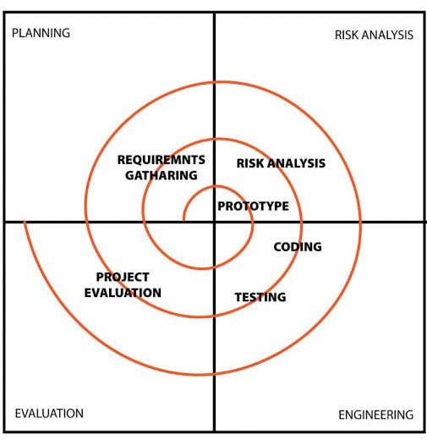
SPIRAL MODEL

Slide 11
FEASIBILITY STUDY
Technical feasibility
Operational feasibility
Economic feasibility

Slide 12
REQUIREMENTS
Types of requirements
Functional requirements
Non-functional requirements?

Slide 13
Use-Case Diagram
User’s possible interactions with a system

Slide 14
Use-Case Diagram
Customer details
login
Create a/c
View account
View tns
profile
Make rp
balance
profile
admin
users
Transaction
debit
loan
deposit
Fine

Slide 15
Sequence diagram
A sequence diagram is a type of interaction diagram because it describes how- and in what order a group of objects works together.

Slide 16
Application
Database
Home page
Login page
Customer
Website
login
access to user
Fil username and password
Verify username & password
Validate user
Invalid user
ok
Select change password
Enter user id new pass
Handle request
Accept id & password
view change password
Access of view other detail
logout

Slide 17
Data Flow Diagrams
Data flow diagram is a graphical or visual representation using a standardized set of symbols.

Slide 18
0-Level Data Flow Diagram
Admin
login
RADHA
KRISHNA FINANCE GROUP
DataBase
USER
login

Slide 19
1-Level Data Flow Diagram
start
Admin
customer
Login
Login
Dashboard
Dashboard
Create customer A/c
View History
View Details & make transaction,
View Account details, profile
Logout

Slide 20
2-Level Data Flow Diagram
start
Customer
Login to system
Dashboard
Admin
Manage account details
Send email to the user
Forgot password
Login
Forgot password
history
Manage insurance details
Transaction
Dashboard
Check credentials
Manage modules
Manage expenditure details
profile
Send email to the user
loan
Manage loan
balance
Manage system admin
Manage roles of user
Manage user permission
Manage report
Logout

Slide 21
E-R DIAGRAM
Entity relationship diagram or E-R diagram can express the overall logical structure of a database graphically.
E-R diagram is a type of flowchart that illustrates how entities such as people ,objects or concepts relate to each other within a system.

Slide 22
Number
Balance
Photo
Address
Address
Photo
Number
Email
Customer
Admin
Email
Name
cid
VIEW MODULES
Name
Account no
aid
Make
transaction
Admin_id
Transaction
Customer_id
did
deposite
debit

Slide 23
COST AND BENEFIT ANALYSIS
Requirement gathering and analysis= 15 days
System design and analysis= 15 days
implement code and test = 30 days
integration and test = 5 days
Effort cost estimation = 300/day/head
total cost of the project= 65* 300= 19,500/-

Slide 24
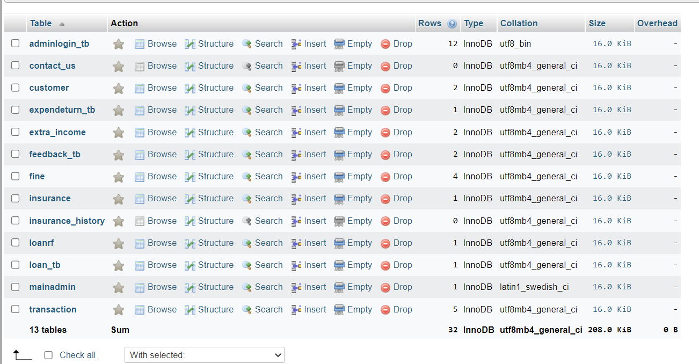
Database Tables

Slide 25
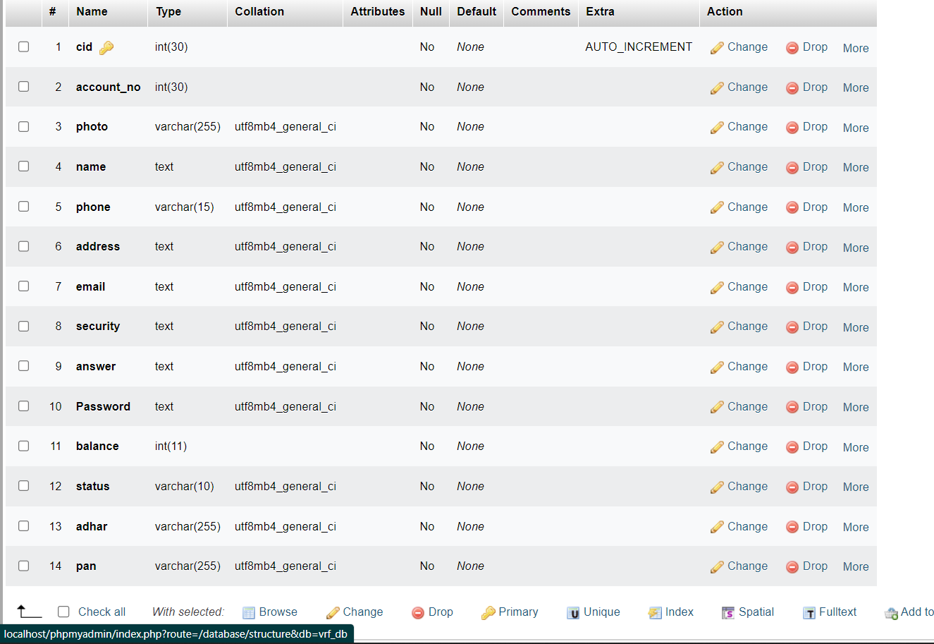
Customer Tables

Slide 26
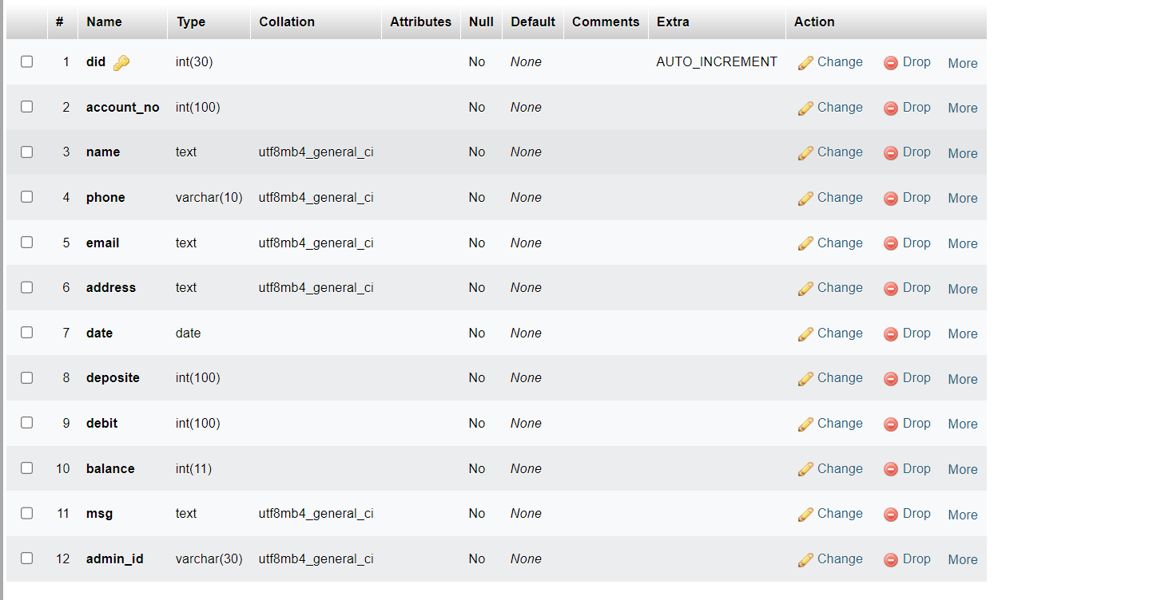
Transaction Tables

Slide 27
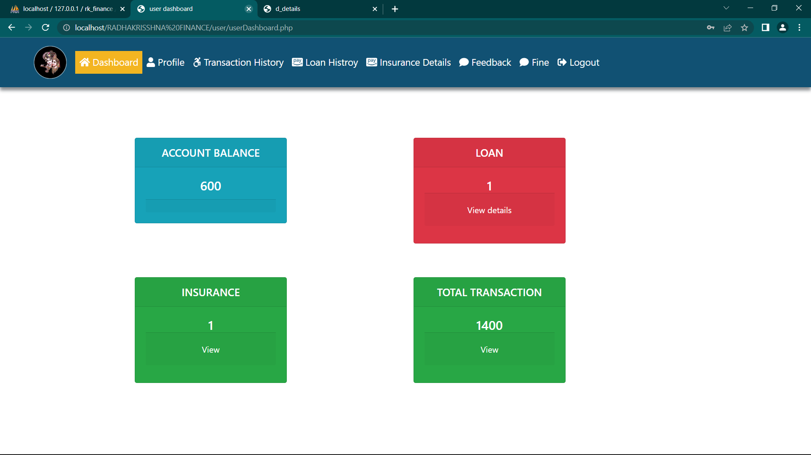
User Dashboard

Slide 28
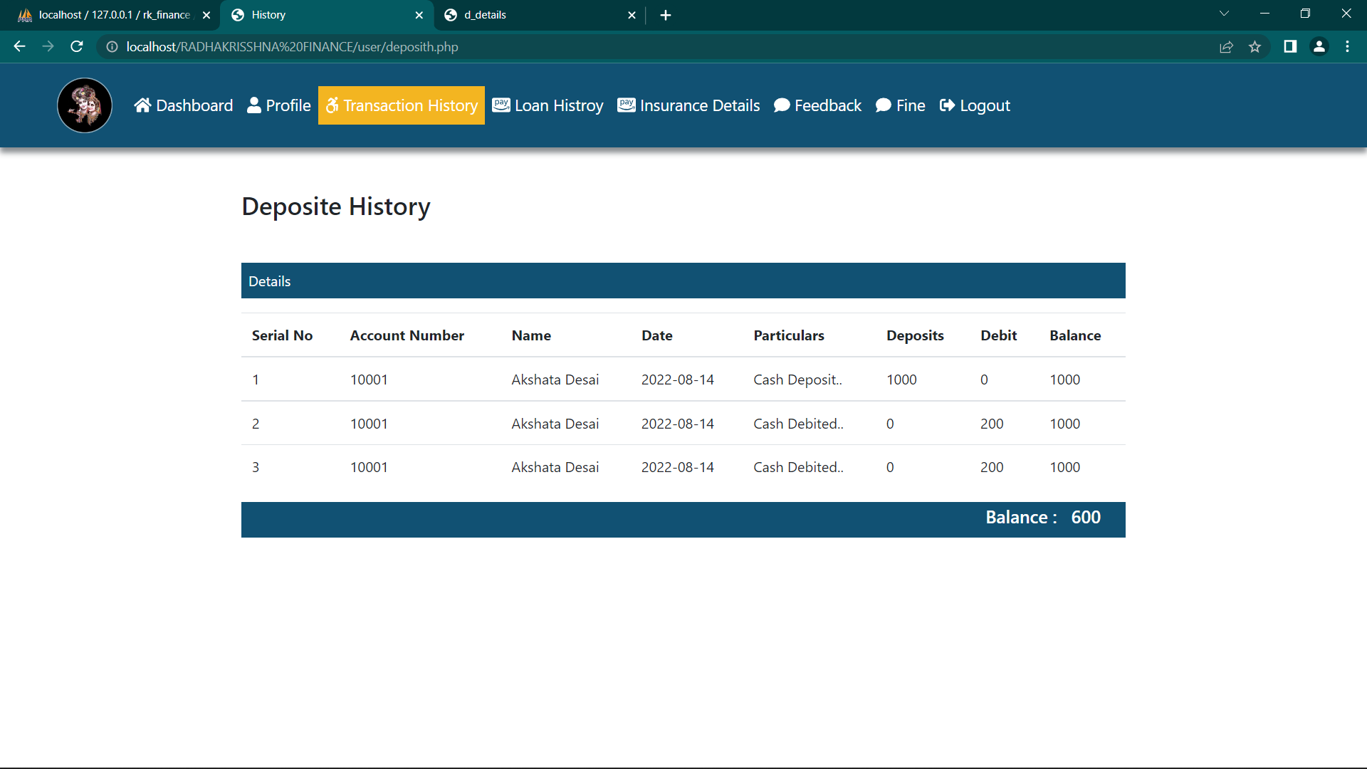
Transaction Details

Slide 29
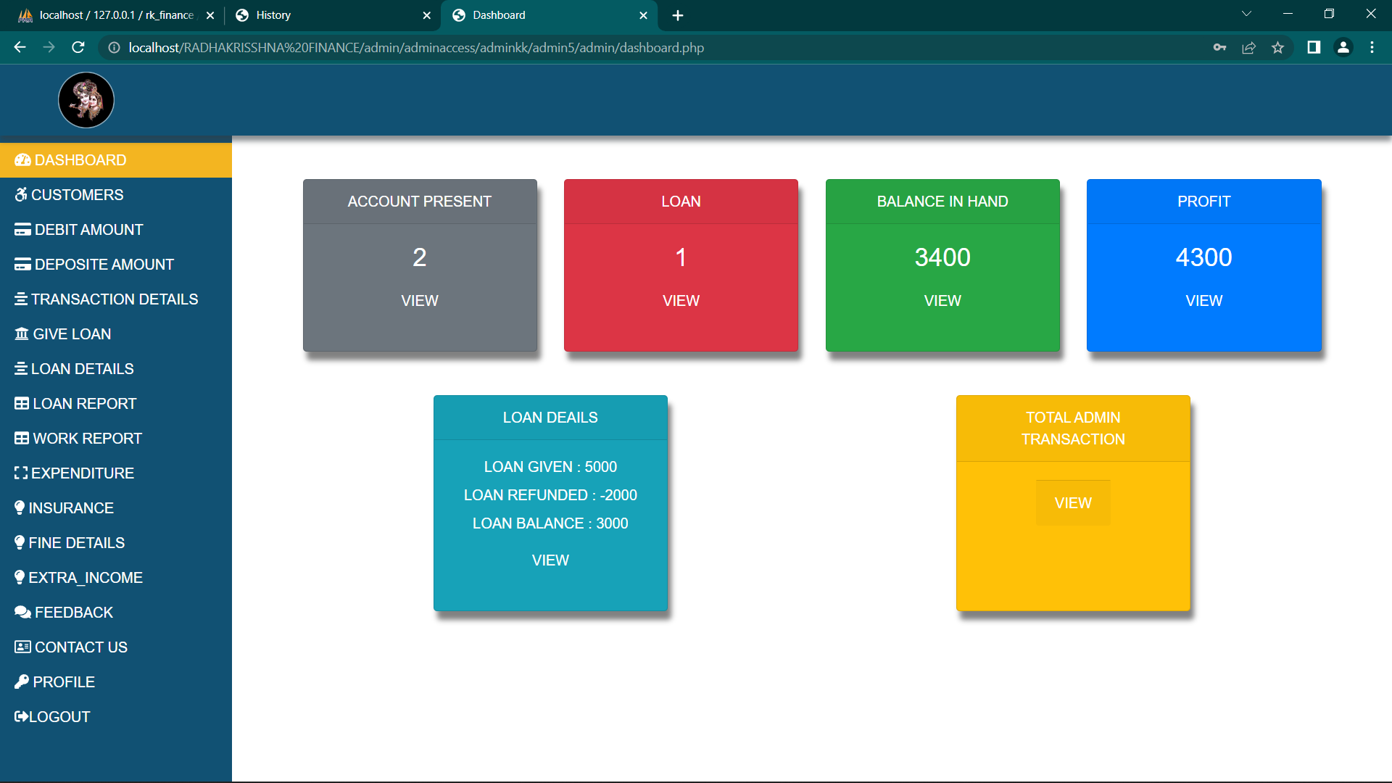
Admin Dashboard

Slide 30
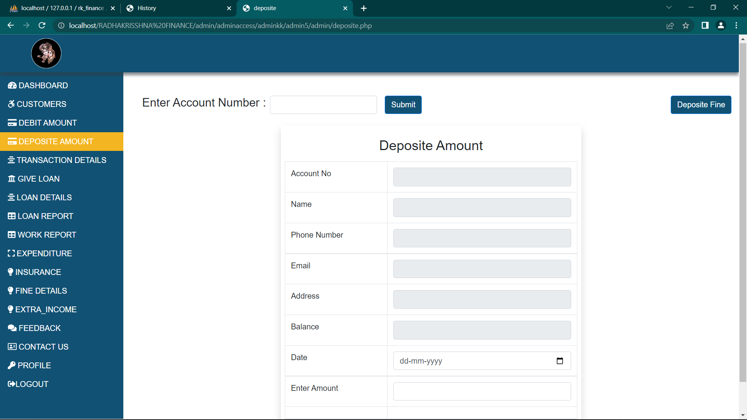
Deposite Amount

Slide 31
CONCLUSION
Radhakrishn Finance Group is a special type of business organization. There is no desire to earn a profit. It is for the betterment of Finance group.

Slide 32
THANK YOU

